Slide 1
What is DevOps?
DevOps is a practice of collaboration between Dev and Operational Team.
DevOps integrates developers and operations teams in order to improve the software delivery process.
Collaboration and co-ordination between dev and operational team
Infrastructure as code
Controlling and managing your infrastructure

Slide 2
History of DevOps
History of DevOps?
It is philosophy or enhancement or optimization of organization Dev and Ops
Philosophy-business works best when efforts are coordinated and collaborative
DevOps efforts as to respond more rapidly to the market changes.
DevOps is need of business demand

Slide 3
DevOps Definitions
It is combination of development and operations.
It is software development method that emphasis on communication,collaboration,integration,automation and measurement of cooperation between software developers and other it professionals.

Slide 4
Why DevOps
Communication barrier or bottlenecks between dev and operational team
System monitoring is very hard, if you have 100 servers and need to update patch on all those servers is tedious.
For any deployment developer needs to wait for operational team.
Provisioning the server is just click away.
Need of seemless integration between development and operations
Growing delivery pipeline.

Slide 5
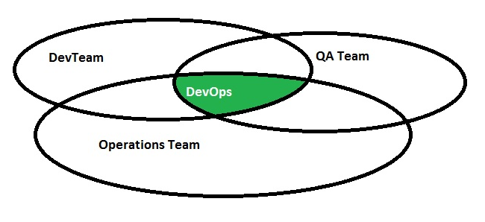
What is DevOps(Diagramatic)

Slide 6
Current Challenges in IT Industry
Continuous Deployment and delivery
Continuous monitoring of the server
Continuous provisioning of the servers which are in different platforms
Every developer change has to go continuous deployment.
Existing tools does not have “infrastructure as a code” capability.
Controlling of entire infrastructure.

Slide 7
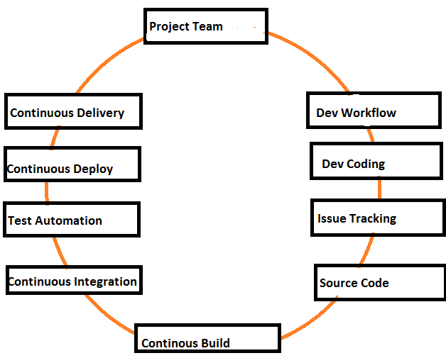
DevOps Architecture

Slide 8
Pre-requisite to learn DevOps
Involved in either Dev or Operational team
Little bit of scripting knowledge or at least interest to learn one scripting language
Knowledge about linux/unix operating system
Brief idea about build and deployment process

Slide 9
Tools that are involved in DevOps
Chef tools and its setup
Puppet tools and its setup
Ruby scripting knowledge
Vagrant
Docker
Jenkins as part of continuous integration tool
Ansible,SaltStack
Any other scripting knowledge is added advantage

Slide 10
Unix Introduction
What is Unix?
Types of Unix?
The Unix Operating System
Files and processes
Unix Architecture

Slide 11
What is Unix?
Unix is an operating system which was introduced in the 1960s.
It is suite of programs which computer make work.
It is stable multiuser, multitasking system of servers,desktops and laptops.
Unix system also has the graphical user interface similar to microsoft windows

Slide 12
Types of Unix
There are many different versions of UNIX although they share common similarities
The most popular varieties of UNIX are, Sun Solaris, GNU/Linux, and MacOs X.

Slide 13
Unix Operating System
The Unix operating system made up of 3 parts. Kernal, shell and programs
Kernal: It is hub of the operating system, and allocates memory to programs, and take care file store, and communication in response to system calls.
Eg: user types rm myfile then shell searches for the file store containing “rm” then request the kernal through the system call for executing rm on my file.
Shell and kernal are work together

Slide 14
Unix OS -contd..
Shell: it is interface between user and kernal. When user enters any command it will send the system call to kernal and perform the operation and return to shell prompt.
Programs or commands which user write the commands
Eg: OS X, Solaris, All Linux

Slide 15
Unix OS contd...
Unix Processes
When a program is started in UNIX, it creates what is known as Process on the system. Every process is assigned a unique serial number called its process id or PID.
Process and process management is becomes more important on UNIX systems.

Slide 16
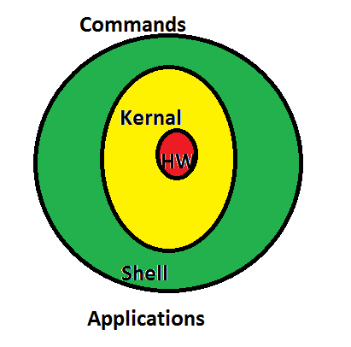
Unix Architecture

Slide 17
Unix Shell- Useful commands
File Management
ls - List files
cd - Change directories
pwd - Print current (working) directory
mkdir - Make a new, empty directory
rmdir - Remove an empty directory
cp - Copy files
rm - Remove files
mv - Move files or directories
find - Find files or folders based on name, date, size, ownership or other parameters

Slide 18
Unix Shell- Useful commands
File Management
ls - List files
cd - Change directories
pwd - Print current (working) directory
mkdir - Make a new, empty directory
rmdir - Remove an empty directory
cp - Copy files
rm - Remove files
mv - Move files or directories
find - Find files or folders based on name, date, size, ownership or other parameters

Slide 19
Introduction to Linux operating system
Linux Components
Kernel: The Linux kernel supports large number of pc hardware devices
Shells and GuIs: Bourne shell and bash shell
GUIs : GNOME and KDE windows like operating system
System Utilities: are commands such as ls,cp,grep,awk,sed,wc and more
Application programs: emacs, c++ compiler.

Slide 20
Linux Admin Commands
Uptime: shows since how long your system is running, it will give hours:minute if it less than a day
W: command will display the users currently logged in and their process along with shows load averages, also shows remote host login time,idle time.
Users: displays currently logged in users
Who: command returns the username and date,time and hostname user has logged in.
Crontab: command lists schedule jobs for current user.

Slide 21
Linux Admin Commands Contd..
Less: command allows quickly view file.
More: command allows quickly view file but it will show percentage.
Ssh: command used to login into the remote host. Eg: ssh test@192.168.3.1
Ftp or sftp: command is used to connect to remote ftp host,sftp(secure file transfer protocol). Eg: ftp 192.168.3.1
You can dump multiple files at one stretch ftp > mput *.txt
You can download multiple files at one stretch ftp > mget *.txt

Slide 22
Linux Admin Commands contd..
Service:command call script located at /etc/init.d/ and execute the script. Service httpd start or /etc/init.d/httpd start
Free: command shows free,total and swap memory information in bytes.
Top: command will display the processor information also tasks managed by kernal at real time. -u for specific user
Lsof: command displays the list of open file by particular user.
Grep: command search for a given string in a file.

Slide 23
Linux Admin Commands contd..
Find: command searches file, string and directories eg: find / -name test
Last: using this command we can watch the user activity in the system.eg: terminal date, time,system rebook and kernal version, very useful command for trouble shoot.
Ps: displays the process information
Kill: kill the process or terminate the process.

Slide 24
Linux commands contd..
File Permission commands
Chmod operation and description
+ adds the designated permission to a file or directory
- Removes the designated permission to a file or directory.
= sets the designated permissions

Slide 25
Virtualization
Virtualization means to create a virtual version of a device or resource, such as a server, storage device, network or even an operating system where the framework divides the resource into one or more execution environments
Run multiple operating systems and applications on a single server
Consolidate hardware to get vastly higher productivity from fewer servers.
Save 50 percent or more on overall IT costs.
Speed up and simplify IT management, maintenance, and the deployment of new applications.

Slide 26
Cloud Computing--Agenda
What is cloud computing ?
Cloud Computing History?
Cloud Components?
Central Server?
Service Models?
Deployment of cloud service?
Why Cloud service is popular?

Slide 27
What is Cloud Computing?
Distributed computing on internet or delivery of computing service over the internet
Eg: yahoo, gmail, or microsoft exchange
Instead of the creating new server for mail exchange, you will buy the service from the service provider
You need not manage the hardware, or software or power supply etc.

Slide 28
History
Concept evolved in 1950(IBM) called RJE (Remote Job Entry Process)
After some time, around 1970, the concept of virtual machines was created.
In 1990s, telecommunication started offering virtualized private networks
In 2006, Amazon provided first public cloud AWS(Amazon web service)

Slide 29
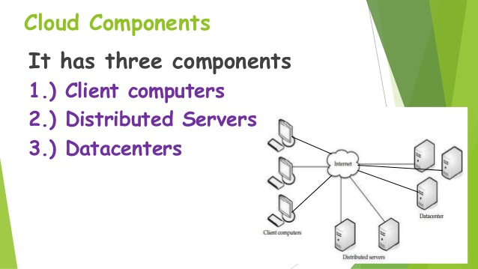
Cloud Components
It has three components
Client computers
Distributed servers
Data Centers

Slide 30
DataCenters
It is collections of servers where application is placed and is accessed via internet
A DataCenter is a facility that centralizes an organization's IT operations and hardware, where it stores, manages, and dessiminates its data.
It is house of network's most critical systems and are vital to the continuity of daily operations.

Slide 31
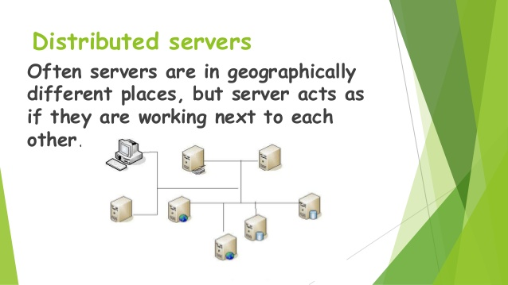
Distributed servers
Often servers are geographically different places but the server acts as they are sitting next to each other

Slide 32
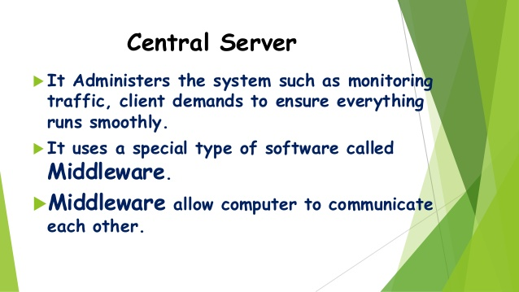
Central Server
It administers the system such as monitoring traffic, client demands to ensure everything runs smoothly
It uses special type of software called middleware
Middleware allow computer to communicate each other.

Slide 33
Service Models-SaaS
SaaS(Software as a Service), Required software, Operating System and network is provided.
allows users to run existing online applications
The Application is hosted centrally
Software testing takes place at a faster rate.
Reduction in IT operational costs
No need to install new software for release updates

Slide 34
Service Model-PaaS
PaaS(Platform as a Service): Operating system and network is provided.
allows users to create their own cloud applications using supplier specific tools and languages
Facilitation of hosting capabilities
Designing and developing application
Integrating web services and databases.
Providing security,scalability and storage

Slide 35
Service Model-IaaS
IaaS(Infrastructure as a Service): Just network is provided
Virtualization of Desktop
Internet availability
Use of billing model
Computerized administrative tasks

Slide 36
Deployment of Cloud service
Public Cloud
Private Cloud
Community Cloud
Hybrid Cloud(Combined Cloud)

Slide 37
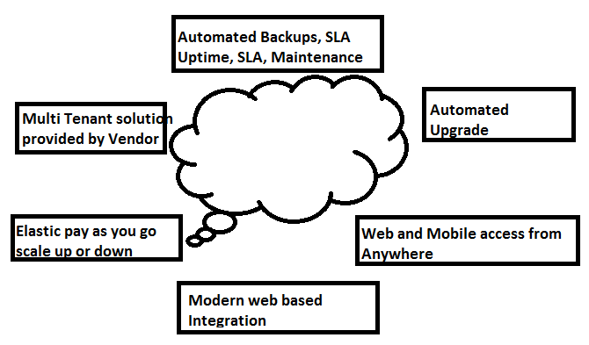
What is Cloud Computing?

Slide 38
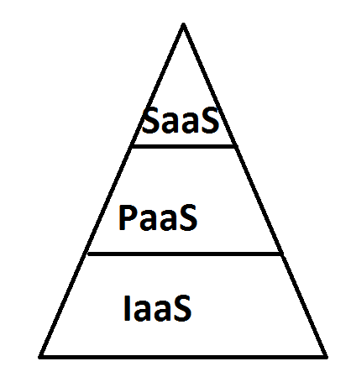
Cloud Computing
Google Apps, Sales Force.com, NetSuite
Lotus,WebFillings,Zoho, Yahoo mail,
Hotmail.
Google App Engine, Force.com,
Windows Azure, Long Jump, Rollbase,
Amazon Elastic BeanStalk,VMware
Cloud Foundry
Amazon Ec2, RackSpace, VMWare,
Joyent,Google Cloud Storage

Slide 39
Cloud Computing Advantages
Advantages
Productivity
Anywhere
Offsite
DataStorage
Easily
upgrade
No IT
Maintenance
Cost
Disaster
Assistance
Always up
Lower Cost Of
Ownership
Use when needed

Slide 40
Git(Version control System)
Git is an open source version control tool
Git Download: https://git-scm.com
Automatic download:https://git-scm.com/download/win
Install the Git from downloaded dump
Git Gui Tools :
GitHub for Mac Tower GitHub for windows
Platforms: Mac Platform:Mac Platform:Windows
Price: Free Price:$69 per user Price:free

Slide 41
Git(Version control System)
git-cola
Platforms: Windows, Mac, Linux
Price: Free
SourceTree
Platforms: Mac, Windows
Price: Free
GitX-dev
Platforms: Mac
Price: Free
Git Extensions
Platforms: Windows
Price: Free
SmartGit
Platforms: Windows, Mac, Linux
Price: $79/user / Free for non-commercial use
giggle
Platforms: Linux
Price: Free
gitg
Platforms: Linux
Price: Free
GitEye
Platforms: Windows, Mac, Linux
Price: Free

Slide 42
GiT Architecture
Index: Stores information about current directory and changes made to it.
Object Database:
Blobs(files): Stored in .git/objects
Indexed by unique hash
All files are stored as blobs.
Trees(Directories)
Commits:One object for every commit
Contains hash of parent , name of author, time of commit, and hash of the current tree.
Tags

Slide 43
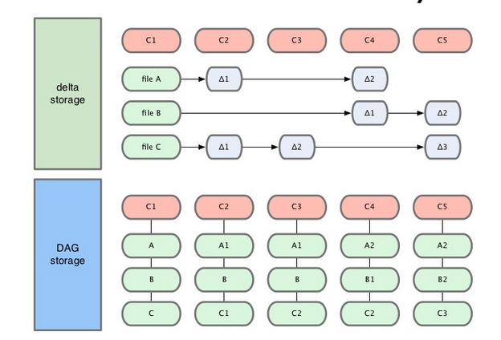
What is Delta Storage?

Slide 44
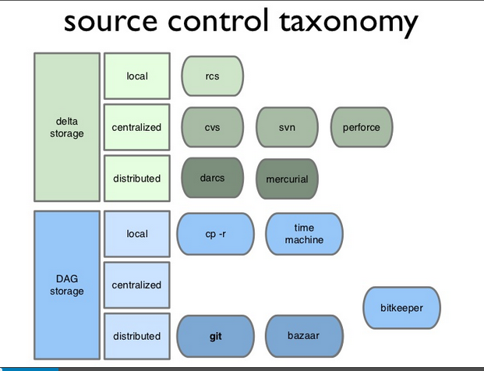

Slide 45
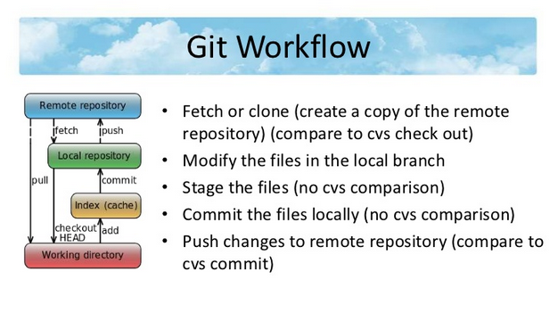

Slide 46
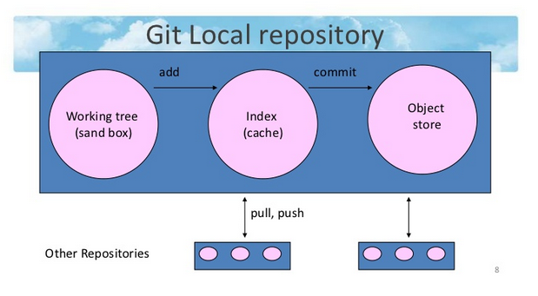

Slide 47
What is DevOps?
DevOps is a practice of collaboration between Dev and Operational Team.
DevOps integrates developers and operations teams in order to improve the software delivery process.
Collaboration and co-ordination between dev and operational team
Infrastructure as code
Controlling and managing your infrastructure

Slide 48
History of DevOps
History of DevOps?
It is philosophy or enhancement or optimization of organization Dev and Ops
Philosophy-business works best when efforts are coordinated and collaborative
DevOps efforts as to respond more rapidly to the market changes.
DevOps is need of business demand

Slide 49
DevOps Definitions
It is combination of development and operations.
It is software development method that emphasis on communication,collaboration,integration,automation and measurement of cooperation between software developers and other it professionals.

Slide 50
Why DevOps
Communication barrier or bottlenecks between dev and operational team
System monitoring is very hard, if you have 100 servers and need to update patch on all those servers is tedious.
For any deployment developer needs to wait for operational team.
Provisioning the server is just click away.
Need of seemless integration between development and operations
Growing delivery pipeline.

Slide 51
What is DevOps(Diagramatic)

Slide 52
Current Challenges in IT Industry
Continuous Deployment and delivery
Continuous monitoring of the server
Continuous provisioning of the servers which are in different platforms
Every developer change has to go continuous deployment.
Existing tools does not have “infrastructure as a code” capability.
Controlling of entire infrastructure.

Slide 53
DevOps Architecture

Slide 54
Pre-requisite to learn DevOps
Involved in either Dev or Operational team
Little bit of scripting knowledge or at least interest to learn one scripting language
Knowledge about linux/unix operating system
Brief idea about build and deployment process

Slide 55
Tools that are involved in DevOps
Chef tools and its setup
Puppet tools and its setup
Ruby scripting knowledge
Vagrant
Docker
Jenkins as part of continuous integration tool
Ansible,SaltStack
Any other scripting knowledge is added advantage

Slide 56
DevOps Opportunities
It is emerging technology
It is growing technology
Every organization is embracing this technology
DevOps professionals are rare to find
IT organization emphasis more on it infrastructure.

Slide 57
Unix Introduction
What is Unix?
Types of Unix?
The Unix Operating System
Files and processes
Unix Architecture

Slide 58
What is Unix?
Unix is an operating system which was introduced in the 1960s.
It is suite of programs which computer make work.
It is stable multiuser, multitasking system of servers,desktops and laptops.
Unix system also has the graphical user interface similar to microsoft windows

Slide 59
Types of Unix
There are many different versions of UNIX although they share common similarities
The most popular varieties of UNIX are, Sun Solaris, GNU/Linux, and MacOs X.

Slide 60
Unix Operating System
The Unix operating system made up of 3 parts. Kernal, shell and programs
Kernal: It is hub of the operating system, and allocates memory to programs, and take care file store, and communication in response to system calls.
Eg: user types rm myfile then shell searches for the file store containing “rm” then request the kernal through the system call for executing rm on my file.
Shell and kernal are work together

Slide 61
Unix OS -contd..
Shell: it is interface between user and kernal. When user enters any command it will send the system call to kernal and perform the operation and return to shell prompt.
Programs or commands which user write the commands
Eg: OS X, Solaris, All Linux

Slide 62
Unix OS contd...
Unix Processes
When a program is started in UNIX, it creates what is known as Process on the system. Every process is assigned a unique serial number called its process id or PID.
Process and process management is becomes more important on UNIX systems.

Slide 63
Unix Architecture

Slide 64
Unix Shell- Useful commands
File Management
ls - List files
cd - Change directories
pwd - Print current (working) directory
mkdir - Make a new, empty directory
rmdir - Remove an empty directory
cp - Copy files
rm - Remove files
mv - Move files or directories
find - Find files or folders based on name, date, size, ownership or other parameters

Slide 65
Unix Shell- Useful commands
File Management
ls - List files
cd - Change directories
pwd - Print current (working) directory
mkdir - Make a new, empty directory
rmdir - Remove an empty directory
cp - Copy files
rm - Remove files
mv - Move files or directories
find - Find files or folders based on name, date, size, ownership or other parameters

Slide 66
Introduction to Linux operating system
Linux Components
Kernel: The Linux kernel supports large number of pc hardware devices
Shells and GuIs: Bourne shell and bash shell
GUIs : GNOME and KDE windows like operating system
System Utilities: are commands such as ls,cp,grep,awk,sed,wc and more
Application programs: emacs, c++ compiler.

Slide 67
Linux Admin Commands
Uptime: shows since how long your system is running, it will give hours:minute if it less than a day
W: command will display the users currently logged in and their process along with shows load averages, also shows remote host login time,idle time.
Users: displays currently logged in users
Who: command returns the username and date,time and hostname user has logged in.
Crontab: command lists schedule jobs for current user.

Slide 68
Linux Admin Commands Contd..
Less: command allows quickly view file.
More: command allows quickly view file but it will show percentage.
Ssh: command used to login into the remote host. Eg: ssh test@192.168.3.1
Ftp or sftp: command is used to connect to remote ftp host,sftp(secure file transfer protocol). Eg: ftp 192.168.3.1
You can dump multiple files at one stretch ftp > mput *.txt
You can download multiple files at one stretch ftp > mget *.txt

Slide 69
Linux Admin Commands contd..
Service:command call script located at /etc/init.d/ and execute the script. Service httpd start or /etc/init.d/httpd start
Free: command shows free,total and swap memory information in bytes.
Top: command will display the processor information also tasks managed by kernal at real time. -u for specific user
Lsof: command displays the list of open file by particular user.
Grep: command search for a given string in a file.

Slide 70
Linux Admin Commands contd..
Find: command searches file, string and directories eg: find / -name test
Last: using this command we can watch the user activity in the system.eg: terminal date, time,system rebook and kernal version, very useful command for trouble shoot.
Ps: displays the process information
Kill: kill the process or terminate the process.

Slide 71
Linux commands contd..
File Permission commands
Chmod operation and description
+ adds the designated permission to a file or directory
- Removes the designated permission to a file or directory.
= sets the designated permissions

Slide 72
Virtualization
Virtualization means to create a virtual version of a device or resource, such as a server, storage device, network or even an operating system where the framework divides the resource into one or more execution environments
Run multiple operating systems and applications on a single server
Consolidate hardware to get vastly higher productivity from fewer servers.
Save 50 percent or more on overall IT costs.
Speed up and simplify IT management, maintenance, and the deployment of new applications.

Slide 73
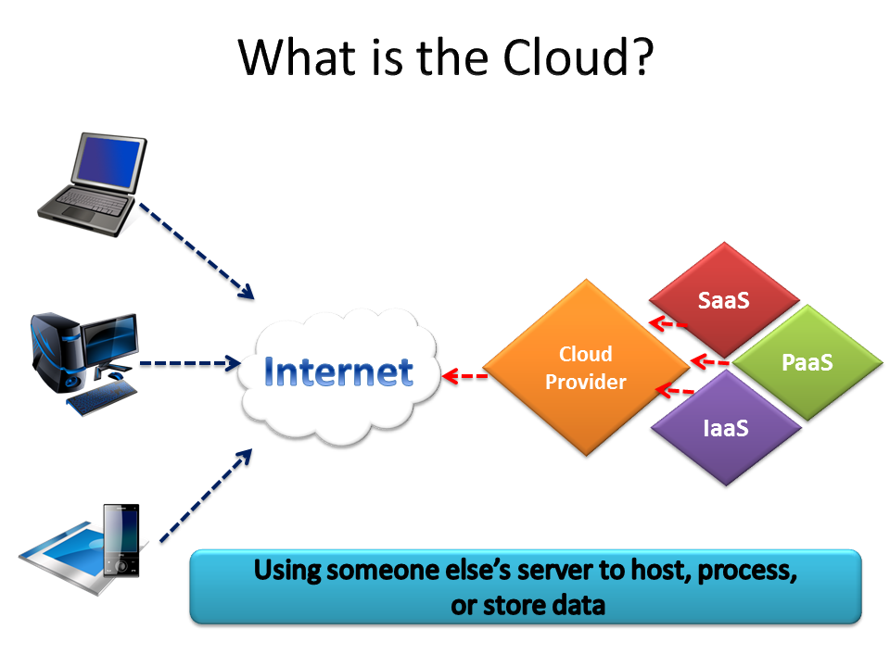

Slide 74
Cloud Computing--Agenda
What is cloud computing ?
Cloud Computing History?
Cloud Components?
Central Server?
Service Models?
Deployment of cloud service?
Why Cloud service is popular?

Slide 75
What is Cloud Computing?
Distributed computing on internet or delivery of computing service over the internet
Eg: yahoo, gmail, or microsoft exchange
Instead of the creating new server for mail exchange, you will buy the service from the service provider
You need not manage the hardware, or software or power supply etc.

Slide 76
History
Concept evolved in 1950(IBM) called RJE (Remote Job Entry Process)
After some time, around 1970, the concept of virtual machines was created.
In 1990s, telecommunication started offering virtualized private networks
In 2006, Amazon provided first public cloud AWS(Amazon web service)

Slide 77
Cloud Components
It has three components
Client computers
Distributed servers
Data Centers

Slide 78
Clients
Clients are the device that the end user interact with cloud
Three types of clients
Mobile
Thick
Thin(Most popular)

Slide 79
DataCenters
It is collections of servers where application is placed and is accessed via internet
A DataCenter is a facility that centralizes an organization's IT operations and hardware, where it stores, manages, and dessiminates its data.
It is house of network's most critical systems and are vital to the continuity of daily operations.

Slide 80
Distributed servers
Often servers are geographically different places but the server acts as they are sitting next to each other

Slide 81
Central Server
It administers the system such as monitoring traffic, client demands to ensure everything runs smoothly
It uses special type of software called middleware
Middleware allow computer to communicate each other.

Slide 82
Service Models-SaaS
SaaS(Software as a Service), Required software, Operating System and network is provided.
allows users to run existing online applications
The Application is hosted centrally
Software testing takes place at a faster rate.
Reduction in IT operational costs
No need to install new software for release updates

Slide 83
Service Model-PaaS
PaaS(Platform as a Service): Operating system and network is provided.
allows users to create their own cloud applications using supplier specific tools and languages
Facilitation of hosting capabilities
Designing and developing application
Integrating web services and databases.
Providing security,scalability and storage

Slide 84
Service Model-IaaS
IaaS(Infrastructure as a Service): Just network is provided
Virtualization of Desktop
Internet availability
Use of billing model
Computerized administrative tasks

Slide 85
Deployment of Cloud service
Types of Cloud
Public Cloud
Private Cloud
Community Cloud
Hybrid Cloud(Combined Cloud)

Slide 86
What is Cloud Computing?

Slide 87
Cloud Computing
Google Apps, Sales Force.com, NetSuite
Lotus,WebFillings,Zoho, Yahoo mail,
Hotmail.
Google App Engine, Force.com,
Windows Azure, Long Jump, Rollbase,
Amazon Elastic BeanStalk,VMware
Cloud Foundry
Amazon Ec2, RackSpace, VMWare,
Joyent,Google Cloud Storage

Slide 88
Cloud Computing Advantages
Advantages
Productivity
Anywhere
Offsite
DataStorage
Easily
upgrade
No IT
Maintenance
Cost
Disaster
Assistance
Always up
Lower Cost Of
Ownership
Use when needed

Slide 89
Maven and its introduction
Maven is a build automation tool used primarily for Java projects. Maven addresses two aspects of building software: First, it describes how software is built, and second, it describes its dependencies.
It will check the compilation and run time errors. It will download all dependency jars from a repository of a project and build the project. If there are any compilation error in the project the build will be fail.
Maven will (after you declare which ones you are using) download all the libraries that you use and and the libraries that they use for you automatically. This is very nice, and makes dealing with lots of libraries ridiculously easy. This lets you avoid "depenendency hell".

Slide 90
Maven and its introduction
It uses "Convention over Configuration" so that by default you don't need to define the tasks you want to do. You don't need to write a "compile", "test", "package", or "clean" step like you would have to in Ant or a Makefile. Just put the files in the places Maven expects them and it should work off of the bat.
Maven also has lots of nice plug-ins that you can install that will handle many routine tasks
Just add them to your pom.xml and they will integrate with everything else you want to do.

Slide 91
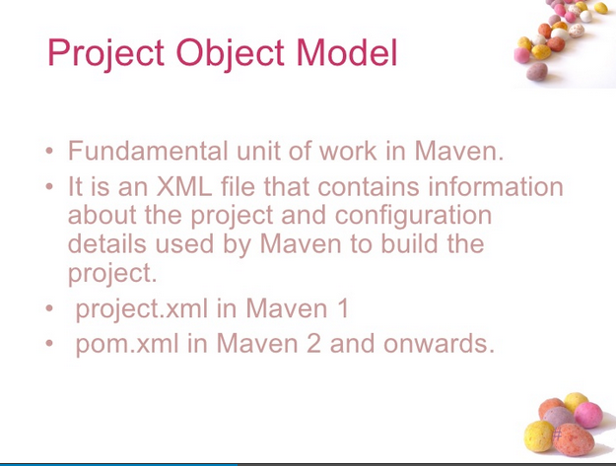

Slide 92
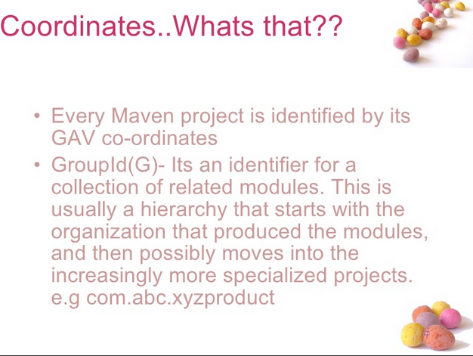

Slide 93
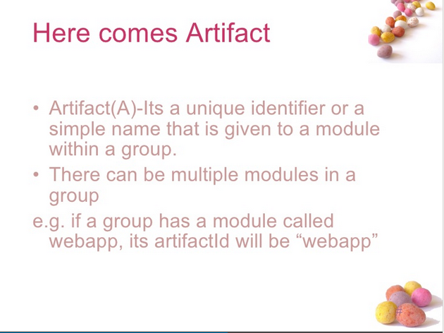

Slide 94
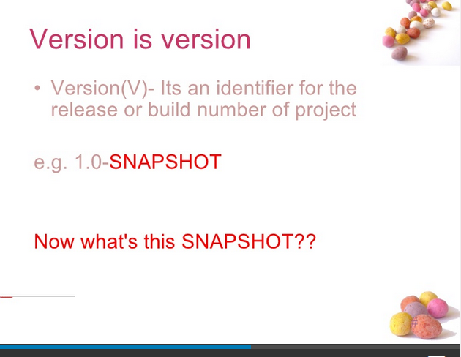

Slide 95
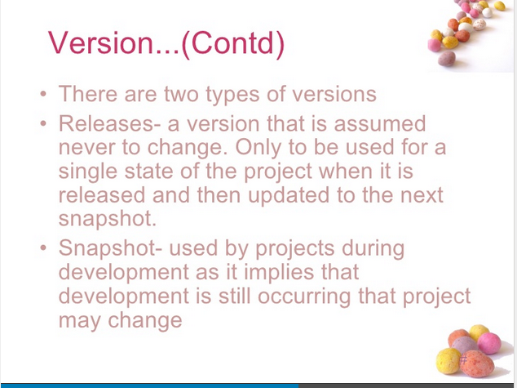

Slide 96
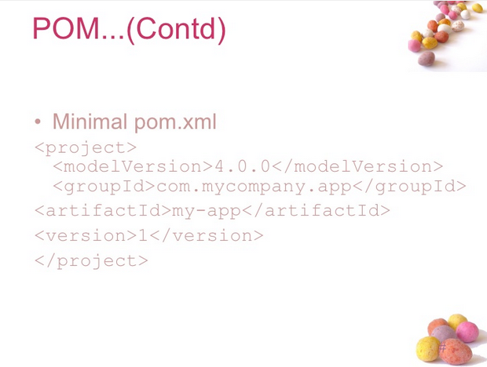

Slide 97
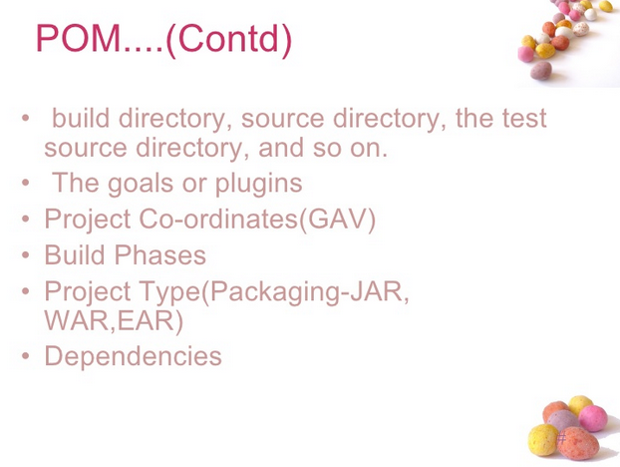

Slide 98
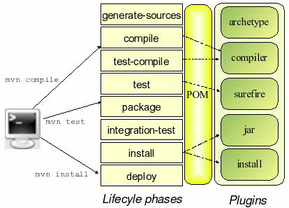
Maven Plugin

Slide 99
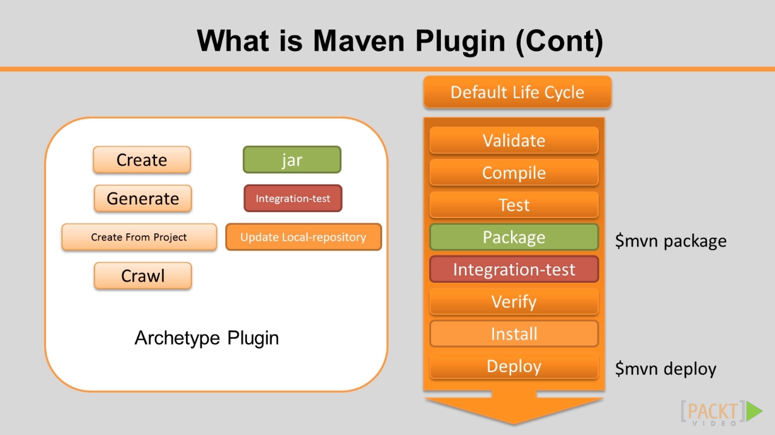

Slide 100
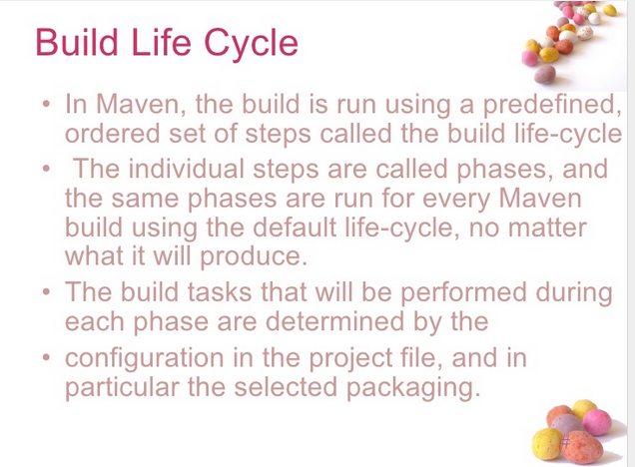

Slide 101
CONTINUOUS INTEGRATION
Jenkins is an open-source continuous integration software tool written in the Javaprogramming language for testing and reporting on isolated changes in a larger code base in real time.
Building/testing software projects continuously. In a nutshell, Jenkins provides an easy-to-use so-called continuous integration system, making it easier for developers to integrate changes to the project, and making it easier for users to obtain a fresh build. The automated, continuous build increases the productivity.

Slide 102
CONTINUOUS INTEGRATION
Monitoring executions of externally-run jobs, such as cron jobs , even those that are run on a remote machine.
For example, with cron, all you receive is regular e-mails that capture the output, and it is up to you to look at them diligently and notice when it broke. Jenkins keeps those outputs and makes it easy for you to notice when something is wrong.

Slide 103
Git(Version control System)
Git is an open source version control tool
Git Download: https://git-scm.com
Automatic download:https://git-scm.com/download/win
Install the Git from downloaded dump
Git Gui Tools :
GitHub for Mac Tower GitHub for windows
Platforms: Mac Platform:Mac Platform:Windows
Price: Free Price:$69 per user Price:free

Slide 104
Git(Version control System)
git-cola
Platforms: Windows, Mac, Linux
Price: Free
SourceTree
Platforms: Mac, Windows
Price: Free
GitX-dev
Platforms: Mac
Price: Free
Git Extensions
Platforms: Windows
Price: Free
SmartGit
Platforms: Windows, Mac, Linux
Price: $79/user / Free for non-commercial use
giggle
Platforms: Linux
Price: Free
gitg
Platforms: Linux
Price: Free
GitEye
Platforms: Windows, Mac, Linux
Price: Free

Slide 105
GiT Architecture
Index: Stores information about current directory and changes made to it.
Object Database:
Blobs(files): Stored in .git/objects
Indexed by unique hash
All files are stored as blobs.
Trees(Directories)
Commits:One object for every commit
Contains hash of parent , name of author, time of commit, and hash of the current tree.
Tags

Slide 106
What is Delta Storage?

Slide 110
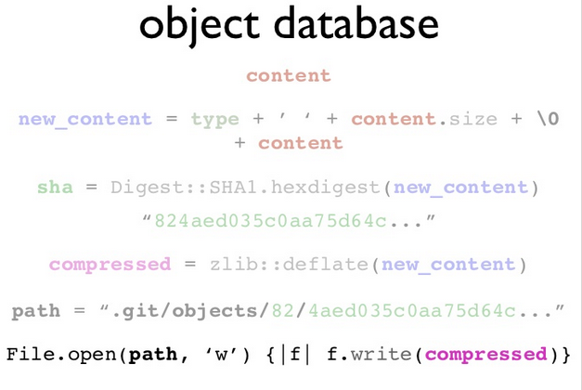

Slide 111
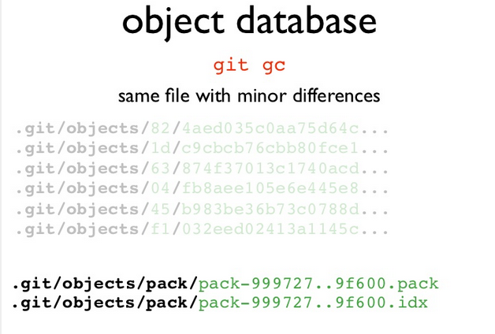

Slide 112
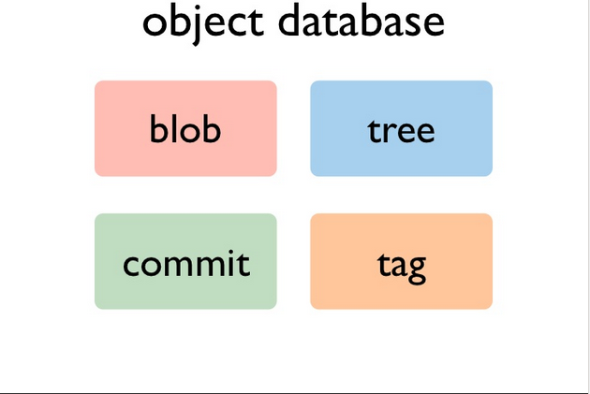
Types of Objects in GiT

Slide 113
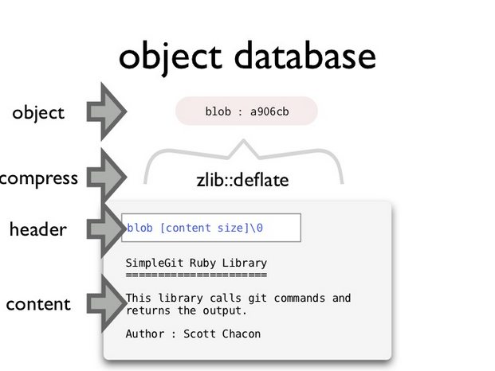

Slide 114
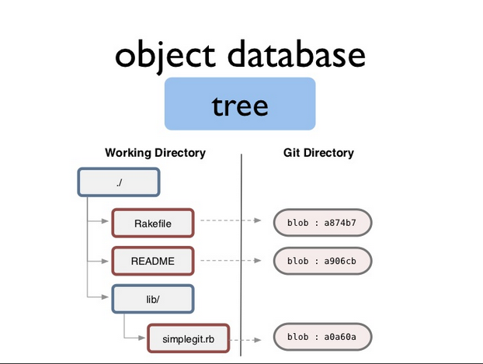

Slide 115
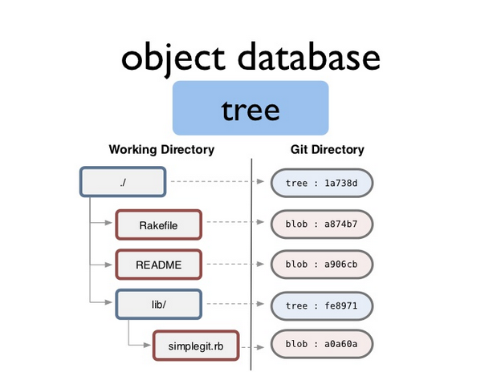

Slide 116
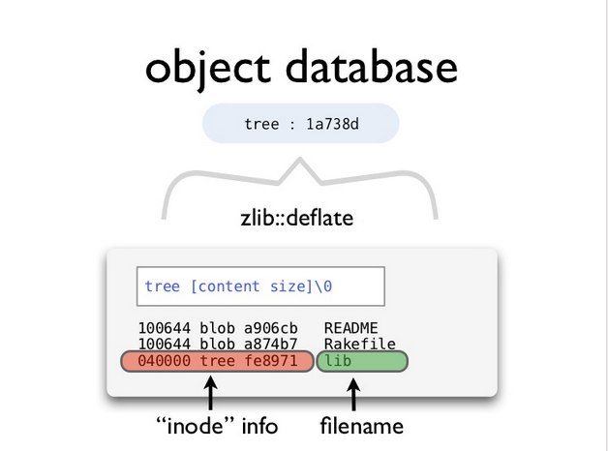

Slide 118
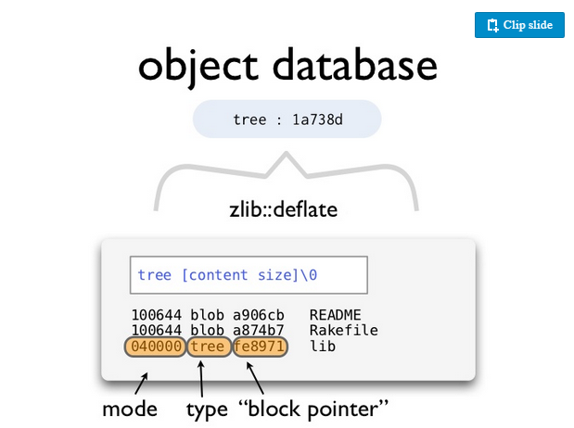

Slide 119
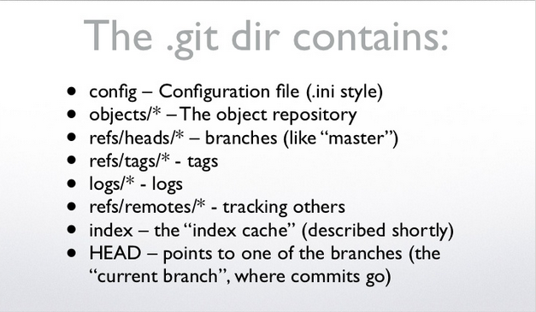

Slide 120
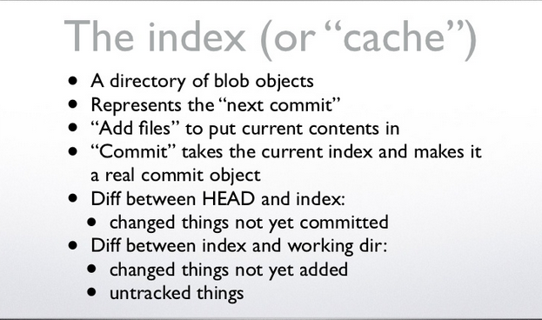

Slide 121
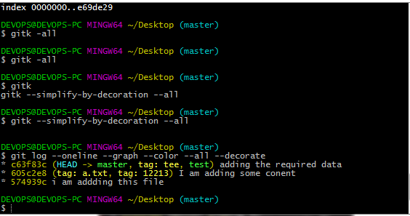
Git(Version control System)
URL to ownload GiT:
This URL will download the Git Automatically.
https://git-scm.com/download/win
It will download the software
Follow the installation steps.

Slide 122
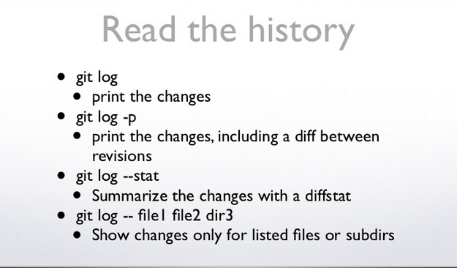

Slide 123
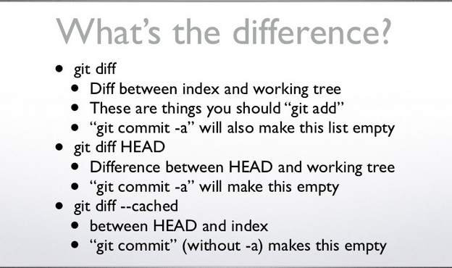

Slide 124
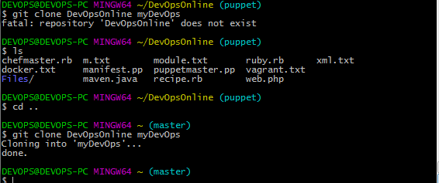

Slide 125
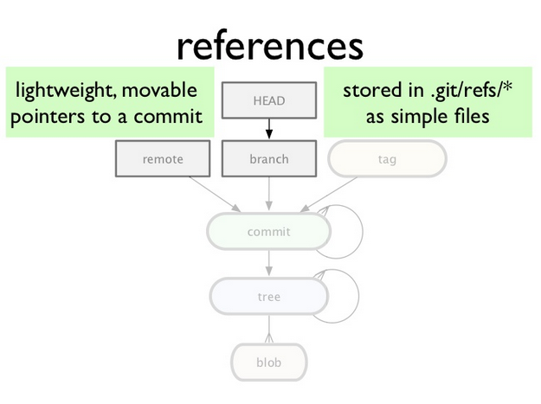

Slide 126
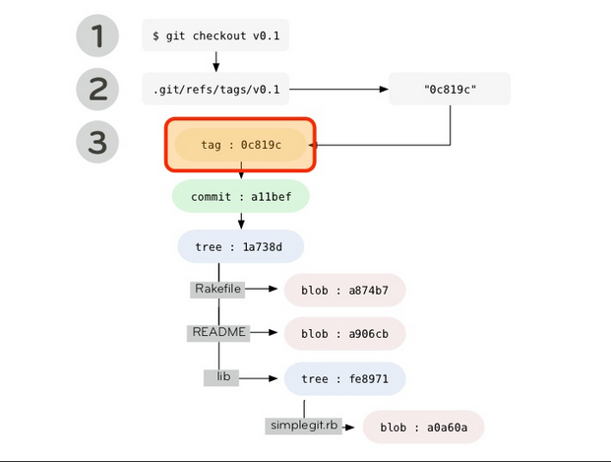

Slide 127
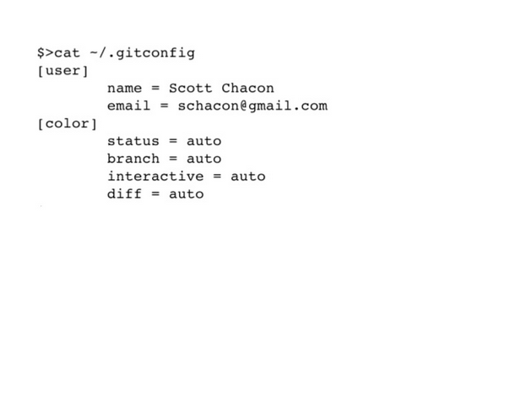

Slide 128
